Slide 1
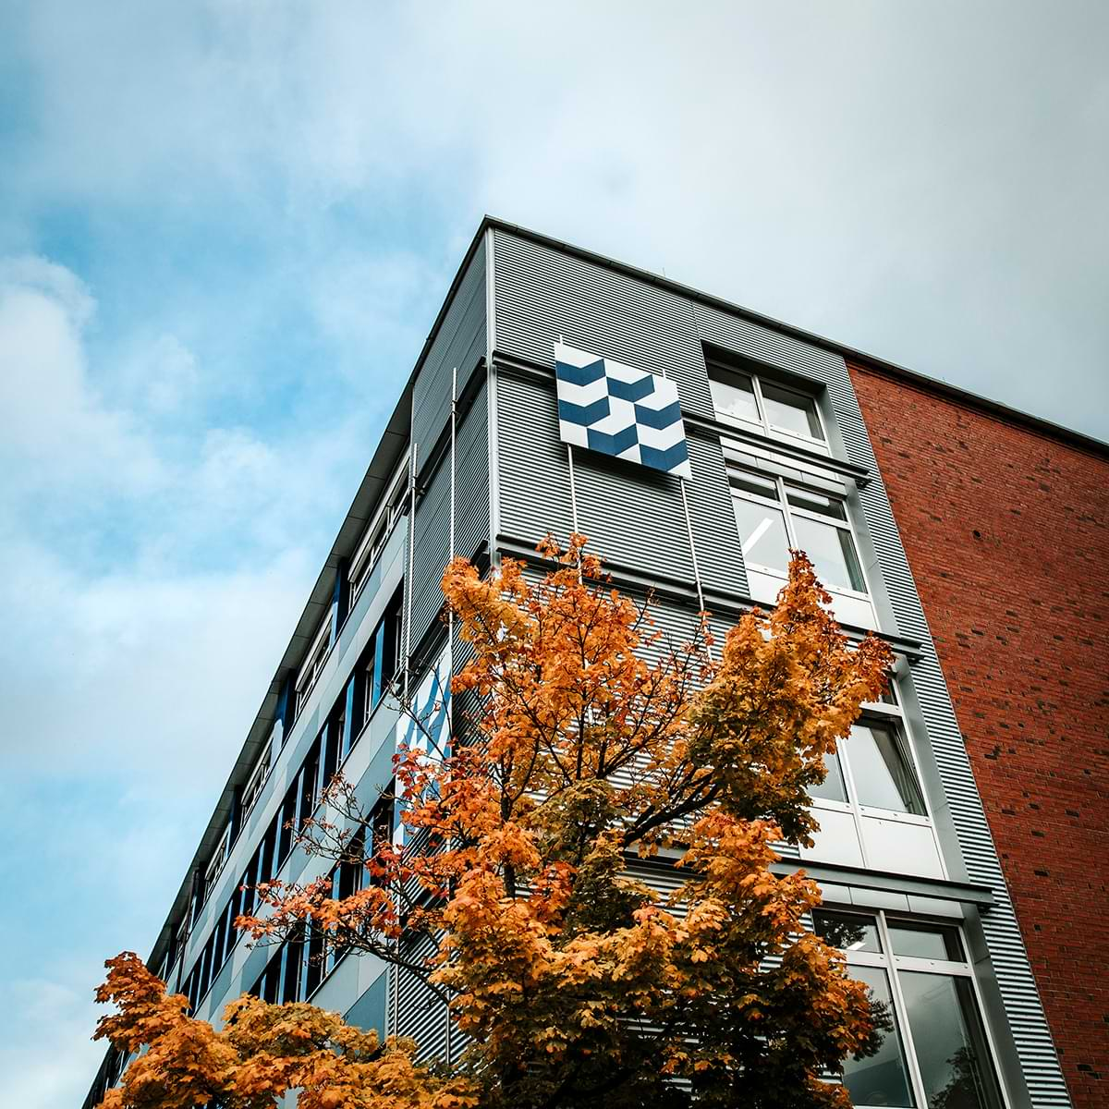
Application Project:
Dangerous good classification for the LHG
Torsten Brockhaus
Damilare Osunleke
Aleksei Trikoz

Slide 2
l. Contents
1. The task
2. The data
2.1 Raw data
2.2 Labeling
2.3 Sample
The model
3.1 YOLOv5
3.2 Training
3.3 Results
Deployment
Recommendations and next steps

Slide 3
The task:
Train a ML solution to classify dangerous goods labels on trucks and deploy it in a Docker container.

Slide 4
The data
Raw data
Six terabytes of data in total
Stored in four folders, one for each gate
One zip folder for each truck that passed the gate
About forty photos for a single truck
Only the images of the back of the trucks were used
In total, we collected a sample of 338.00 images, of which we examined 70.000 manually

Slide 5
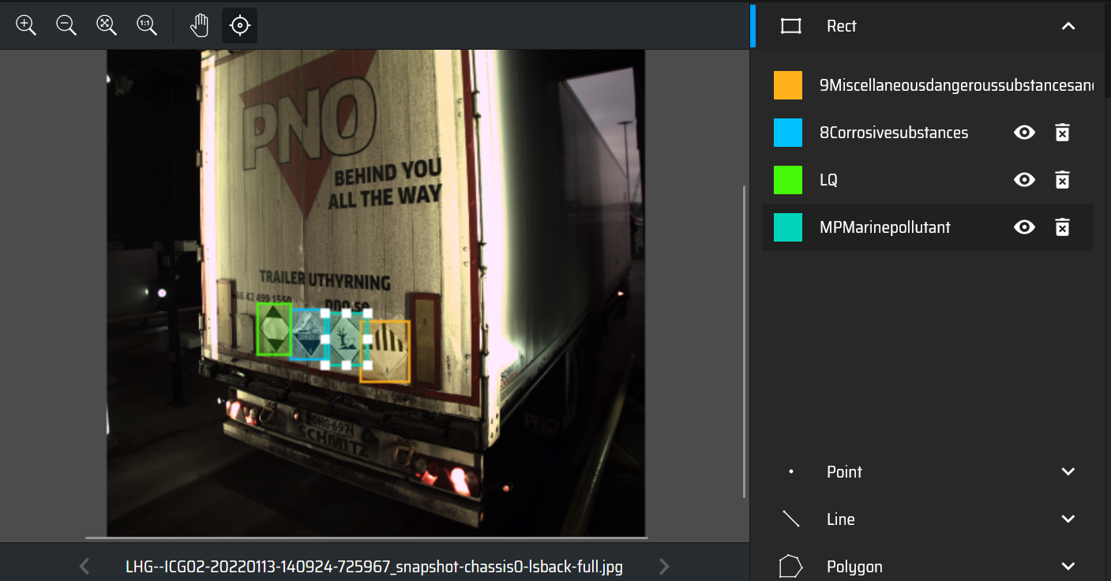
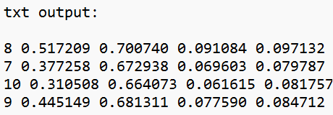
The data
Labeling

Slide 6
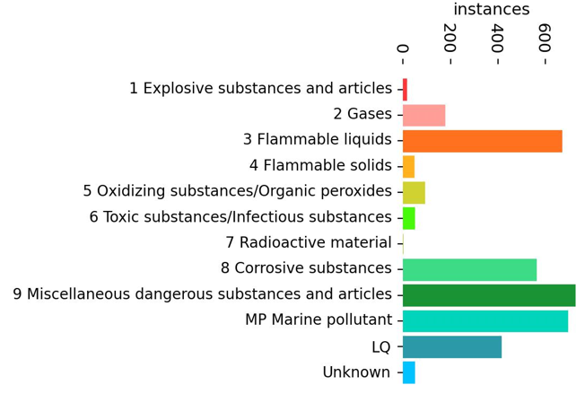
The data
Sample
Of the 70,000 images, 2.470 images have atleast one sign
Sample is heavily unbalanced
Consists of images of different times of day with different lighting

Slide 7
The model
YOLOv5
Acronym for "You only look once“
Built on PyTorch
Version 5 published in 2020
Can predict multiple bounding boxes and class probabilities
Provides high speed and processes images in real time with minimal latency
Pre-trained on COCO dataset (330K images, 1.5 million object instances, 80 object categories)
Can be fine-tuned with user-defined datasets
Built-in image augmentation
GNU Affero General Public License v3.0

Slide 8
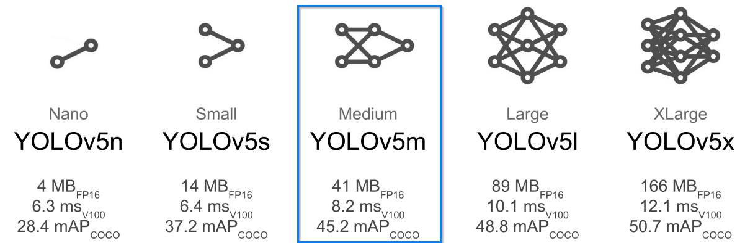
The model
YOLOv5m
Our choice – Medium size model
291 layers
20.915.769 parameters
a good compromise between the speed and accuracy

Slide 9
The model
Training
Of the 2,470 images, 2,270 were used for training and 200 for testing
265 images without sings were added to reduce false positives
Image size (resolution) – 640. (Also, possible train at 1280 resolution).
Train and test pictures resolutions should be the same for better accuracy
Training requires powerful hardware, especially GPUs
Due to the lack of powerful hardware, the training was performed on Google Colab
Google Colab provides limited access to powerful CPUs, GPUs, and RAM
For 100 epochs in 16 batches, the total runtime in Google Colab was about 3.5 hours.

Slide 10
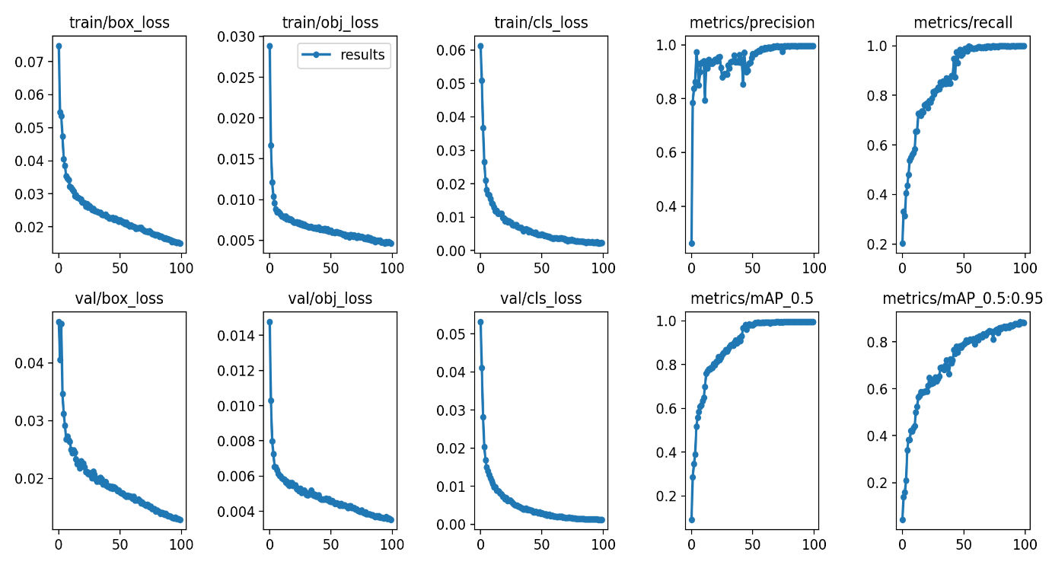
The model
Training results
mAP_0.5 = 0.99458
mAP_0.95 = 0.8817
Increasing the epochs to 200 did not significantly improve the model's performance.

Slide 11
The model
Test results
Class | Instances | Precision | Recall | mAP50 | mAP50-95
all | 135 | 0.902 | 0.915 | 0.951 | 0.793
2 Gases | 8 | 0.807 | 0.75 | 0.781 | 0.723
3 Flammable liquids | 23 | 0.876 | 1 | 0.976 | 0.782
5 Oxidizing substances | 5 | 0.962 | 1 | 0.995 | 0.906
6 Toxic substances | 3 | 1 | 0.778 | 0.995 | 0.764
8 Corrosive substances | 19 | 0.896 | 0.905 | 0.964 | 0.771
9 Miscellaneous dangerous | 28 | 0.923 | 1 | 0.988 | 0.815
MP Marine pollutant | 31 | 0.935 | 1 | 0.995 | 0.844
LQ | 18 | 0.82 | 0.889 | 0.917 | 0.741

Slide 12
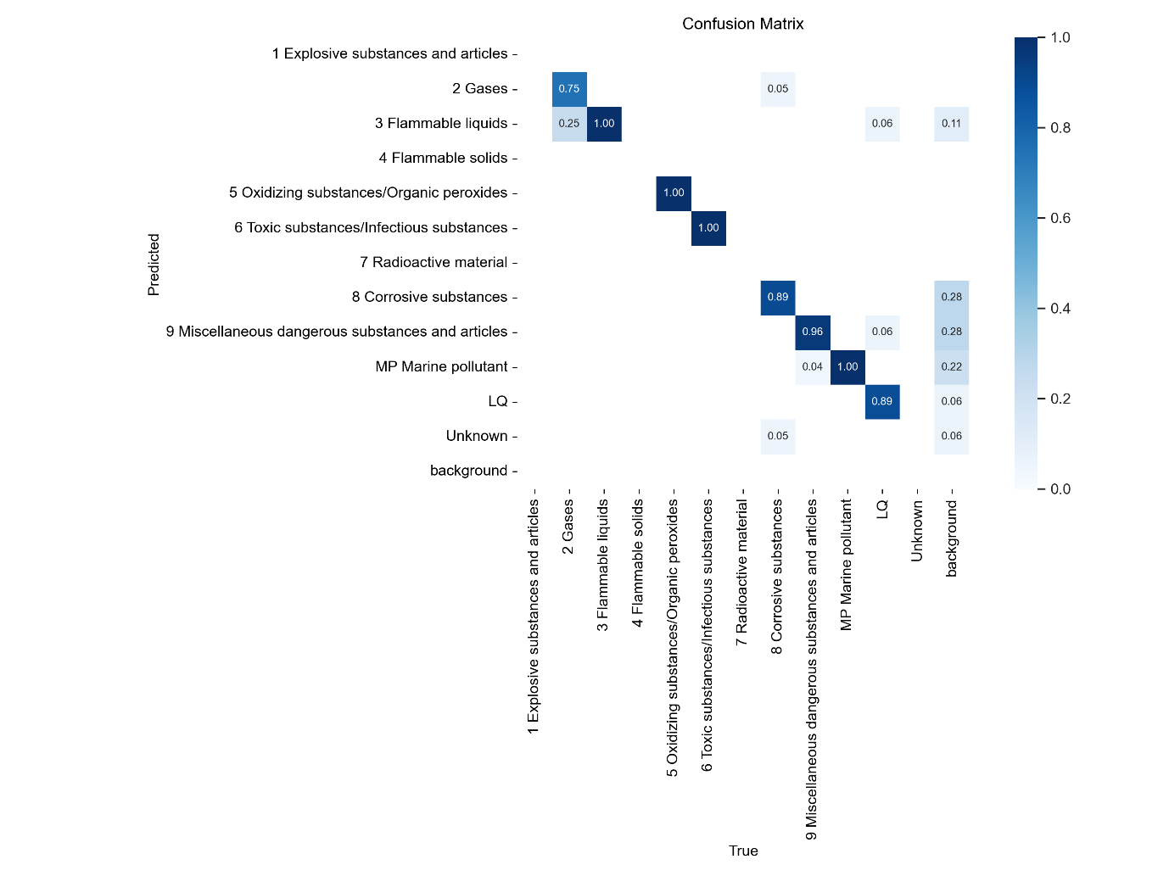
The model
Test results

Slide 13
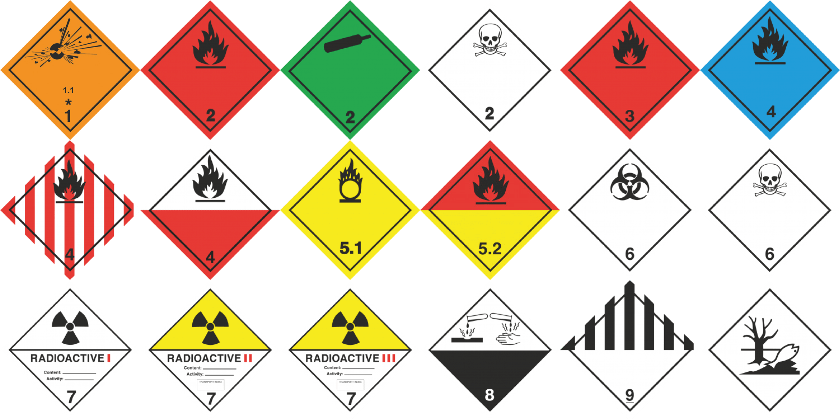
The model
Test results
Very similar signs for different classes can be an explanation for the underperformance of a class.

Slide 14
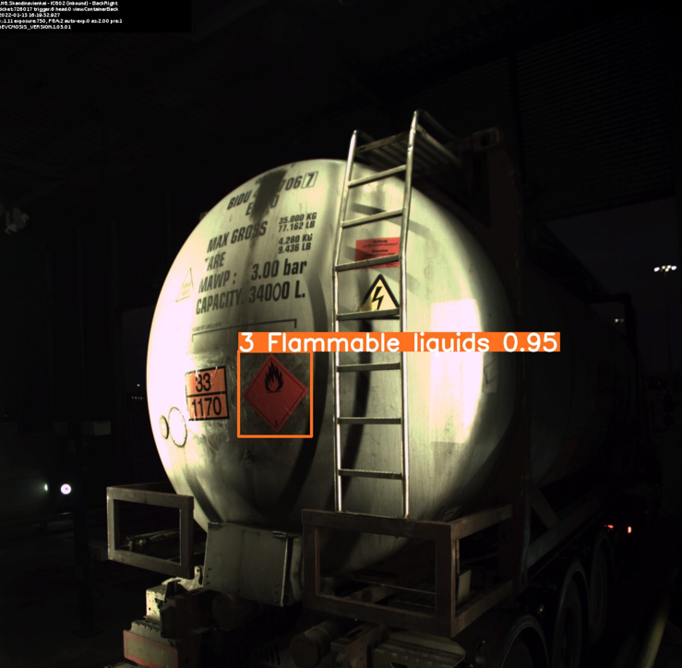
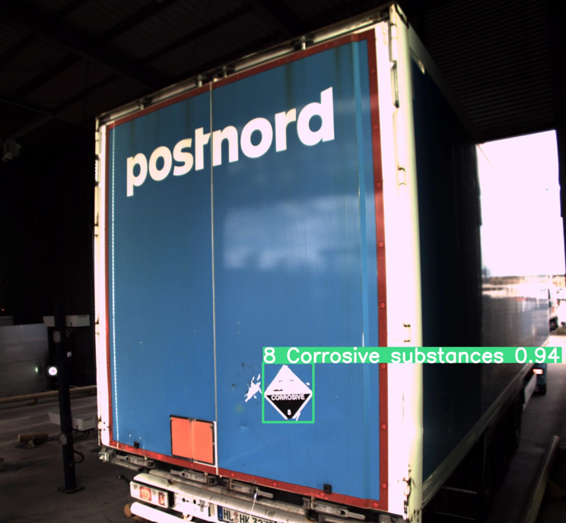
The model
Examples

Slide 15
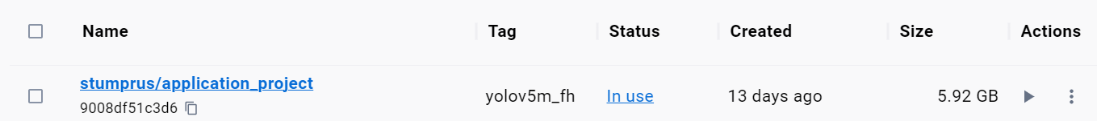
Deployment
Model deployment
The BentoML platform was used for the deployment
The model was containerized as a Docker image (5.92 GB)
Can be downloaded and run on local machines

Slide 16
Recommendations and next steps
The recommendations below are based on the outcome of the project:
Adopt this model for identifying dangerous goods labels on trucks.
In the meantime, perform second-level checks when label 2 is detected. This is due to relatively low recall for that class and its misidentification as label 3.
Retrain the model, but split label 2 into its constituent sub-labels before training
Integrate the model with the existing booking data from the LHG logistics system for auto verification

Slide 17
Image sources
(1)https://www.fh-kiel.de/typo3conf/ext/fh_kiel/Resources/Public/Images/News/fachhhochschule-kiel-campus-ecke.jpg
(2) https://www.lubbers.net/wp-content/uploads/2022/06/ADR.png

Slide 18
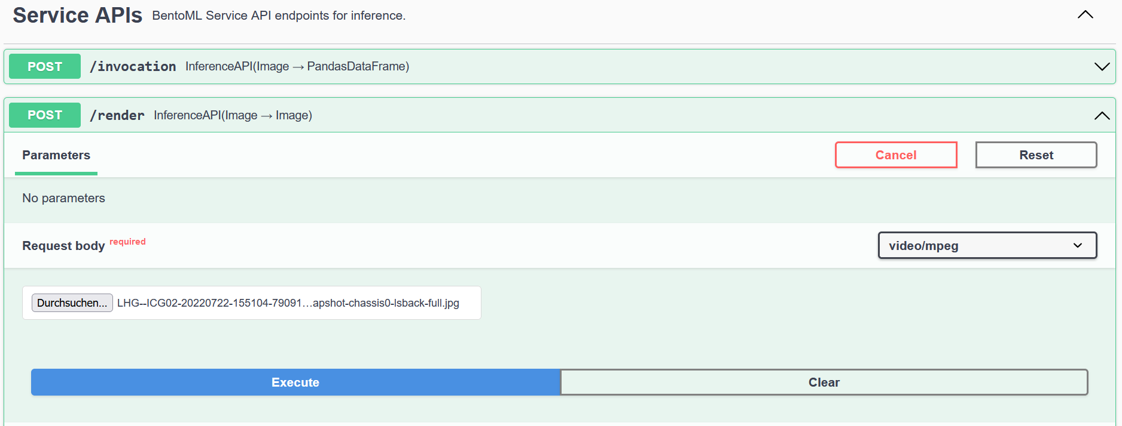
Backup
Service APIs

